Slide 1
Recitation 3
Mini Lecture

Slide 2
Outline
Part 1: Function
Part 2: Conditional Statements, If/else
Part 3: Recitation3Problem1.m

Slide 3
What is a Program?
Functions
Program
Inputs
Outputs
May expect certain variables or conditions to start
May return certain variables at the beginning
A set of commands for a computer to execute

Slide 4
Programs in MATLAB
Functions
In MATLAB, most of the programs you will write will be in the form of functions
We generally write functions so that they can be universally applicable to a certain set of inputs
C = xor(A,B) will work on any bits A and B.
x = abs(y) will work on any number y...
We write user created functions so that they can be used in the same way as built in functions

Slide 5
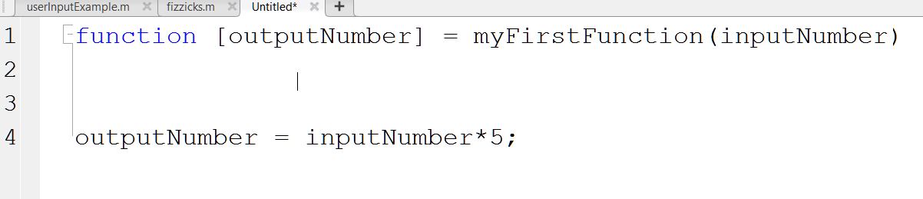
Functions in MATLAB: Syntax
Functions
Let’s MATLAB know that this .m file is a function
Inputs
Outputs
Program
Name you will use to “call” the function from elsewhere. MUST MATCH FILE NAME

Slide 6
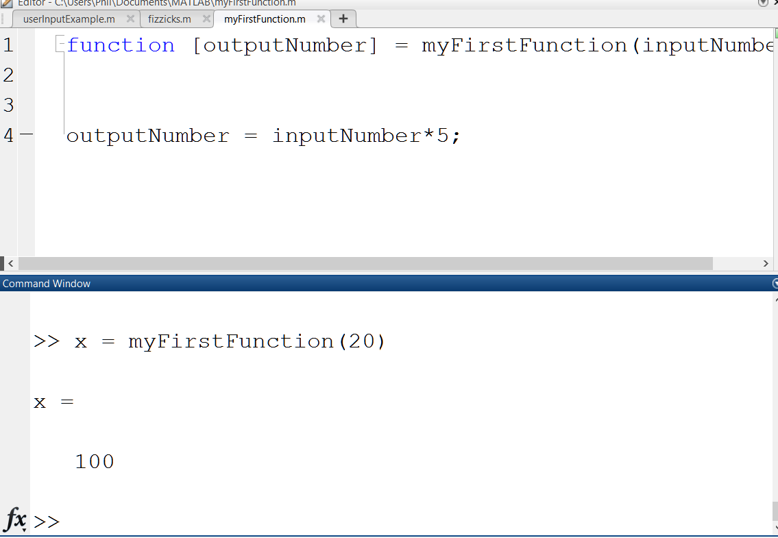
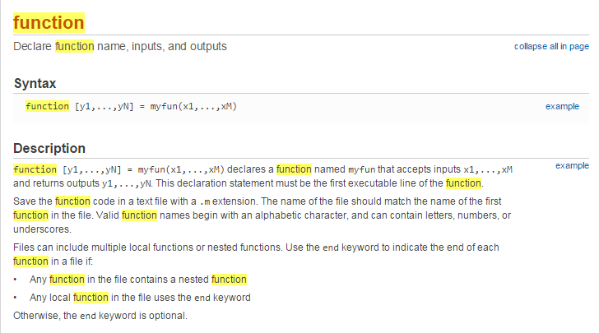
Functions in MATLAB syntax
Functions
Now, elsewhere in MATLAB...

Slide 7
Conditional Statements
Conditional Statements
Conditional statements are ways to get our programs to react to logic or specific cases
What if something should behave differently if a number is zero?
What if you only want to do a calculation if the input is correct?

Slide 8
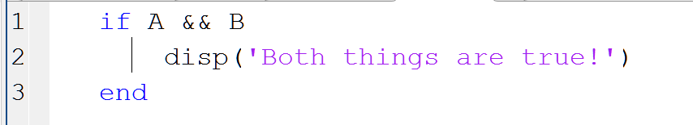
if statements
Conditional Statements
if statements are the most basic conditional statement in MATLAB
Statement with Boolean result
Things to do if Boolean is true
Marked end to things to do if true

Slide 9
What if we are working with numbers?!
Conditional Statements
Fear not! Comparative statements are here
Compare numbers, return Booleans
Name | Syntax | Example
Equals | == | 1 == x
Not Equal | ~= | 2~=m
Greater than | > | z > 0
Less than | < | t < x
Greater than or equal to | >= | mass >= 100
Less than or equal to | <= | time <= expiration

Slide 10
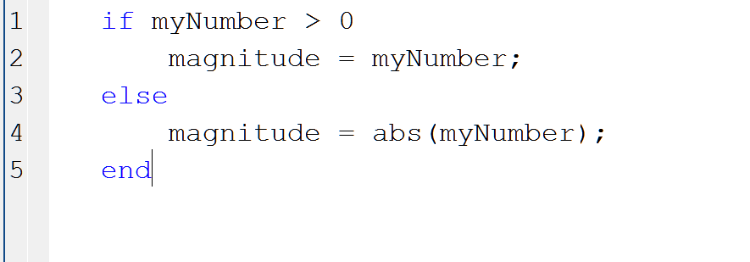
if/else
Conditional Statements
For when you want to have a backup plan
Statement with Boolean result
Things to do if Boolean is true
Things to do if Boolean is false
Marked end of conditional commands

Slide 11
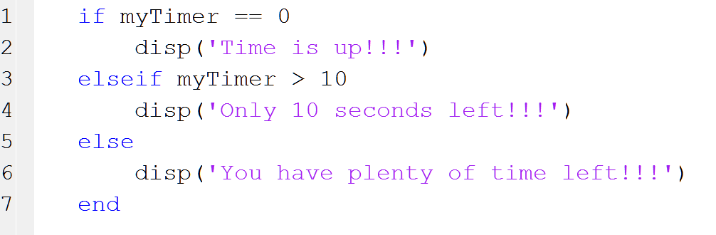
if/elseif
Conditional Statements
For when you want to have multiple backup plans
Statement with Boolean result
Things to do if Boolean is true
Additional Statement with Boolean result. You can have any number of these
Things to do if Additional Boolean is true, as long as the first Boolean was false
Things to do if all Booleans are false
Marked end of conditional commands

Slide 12
Switch/case/otherwise
Conditional Statements
For when you need to check for a bunch of different cases
Everything done with a switch can be done with if/elseif, FYI

Slide 13
Naming a script – Reminder!!
Scripts and I/O
Scripts must follow the same naming rules as variables when you save them
No spaces → my script
No special characters → #$*!@script
Underscores OK → my_script
Can’t start with numbers → 1coolScript
Usually a good idea to name your script after what it does
CalculateMyGrade
findThePressure

Slide 14
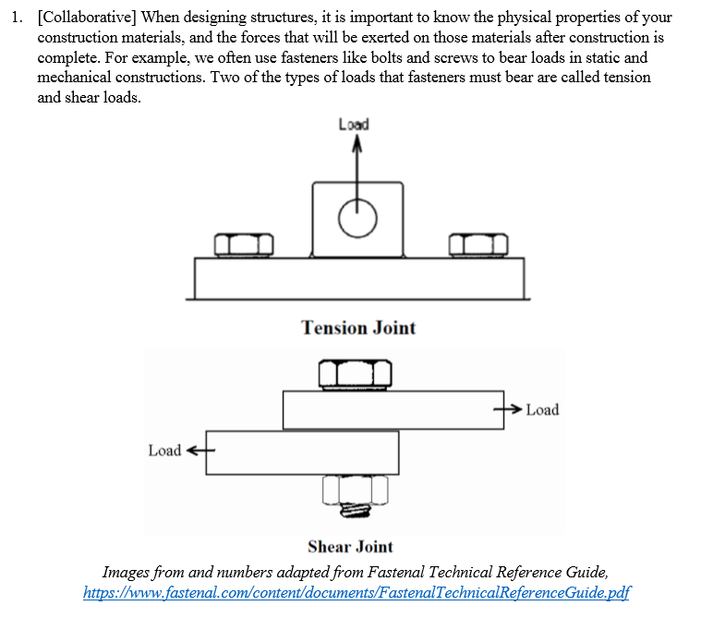
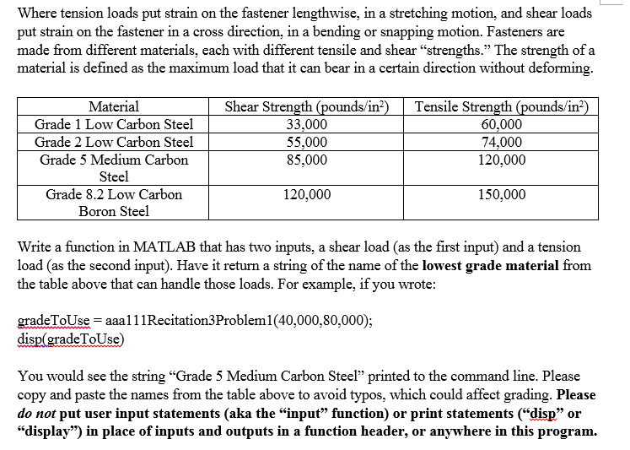
hc667Recitation3Problem1.m

